Slide 1
Dynamo for BIM Managers
aka Managing Dynamo and Dynamo for Managing
Mostafa El Ayoubi
Design Technology Expert | Data Shapes
John Pierson
Design Technology n00b | Parallax Team
Aaron Maller
Director | Parallax Team
Sol Amour
Product Manager : Dynamo | Autodesk
Jostein Olsen
Good Monkey | Bad Monkeys

Slide 2

preflight

Slide 3
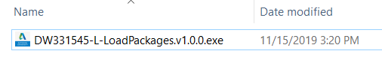
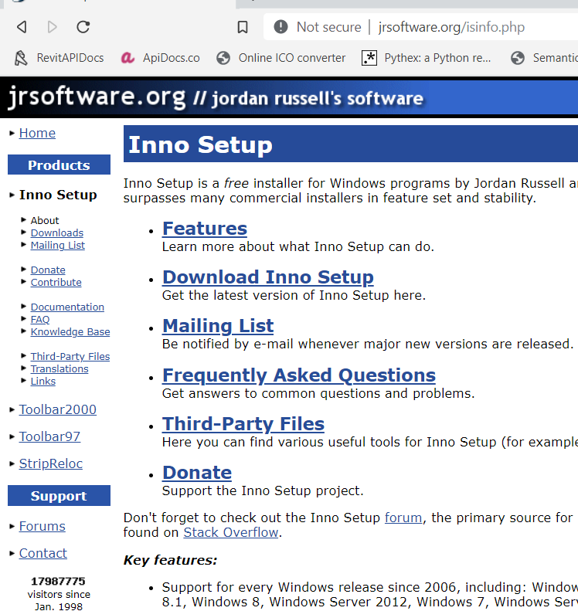
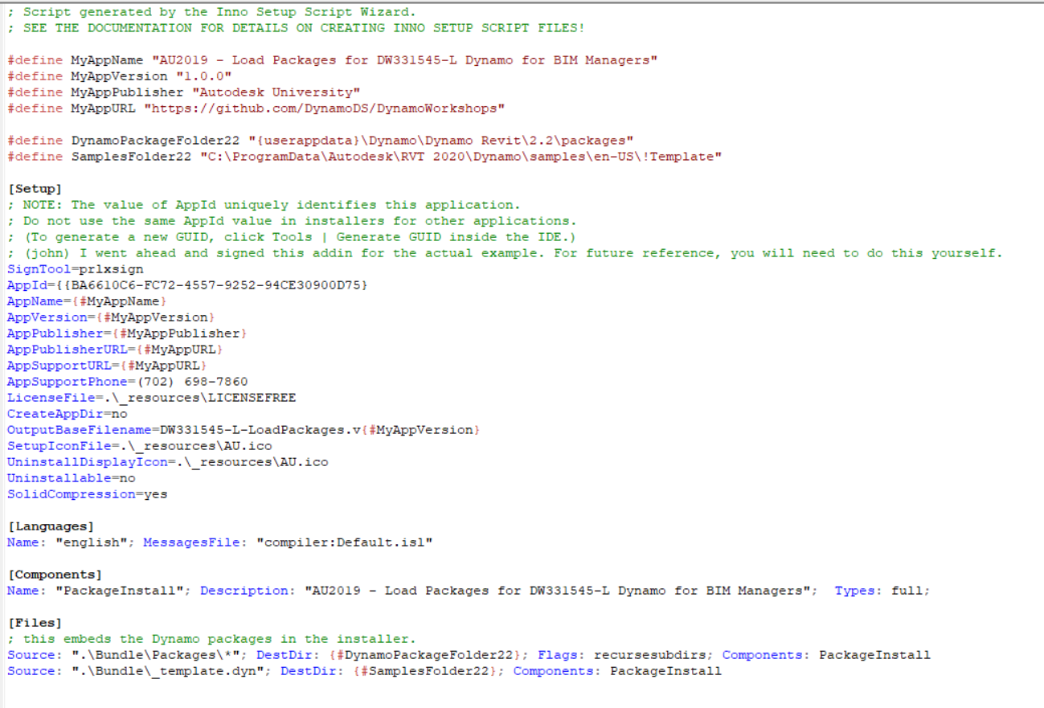
Package Deployment Options

Slide 4
unraveling dynamo

Slide 5

Dynamo Review

Slide 6
Dynamo 1.3.4
Support for Revit 2017-2019
XML-Based.
Pretty darn stable!
Being phased out with Revit 2020

Slide 7
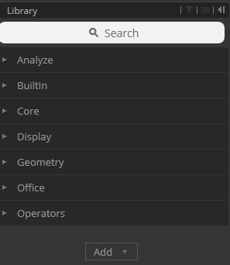
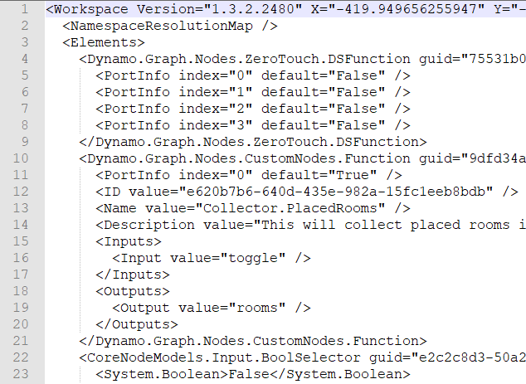
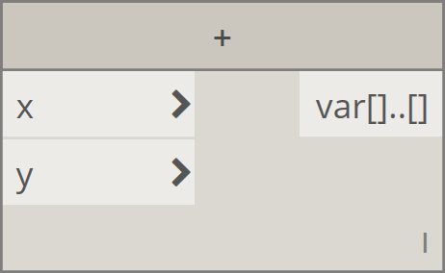
Version Differences - 1.3.4
Same library for several years.
Packages bundled within the library categories
Node in Dynamo 1.3.3
XML-Based file format
Note the “<>”

Slide 8
Dynamo 2.0.x
Released with Revit 2018 and offers compatibility for 2017-2019
JSON based approach
Migration strategies are difficult resulting in slower adoption (IMO)
Not backwards compatible with 1.3.x
Enabling of extensions via package manager

Slide 9
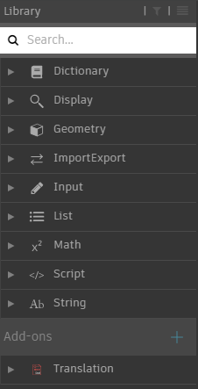
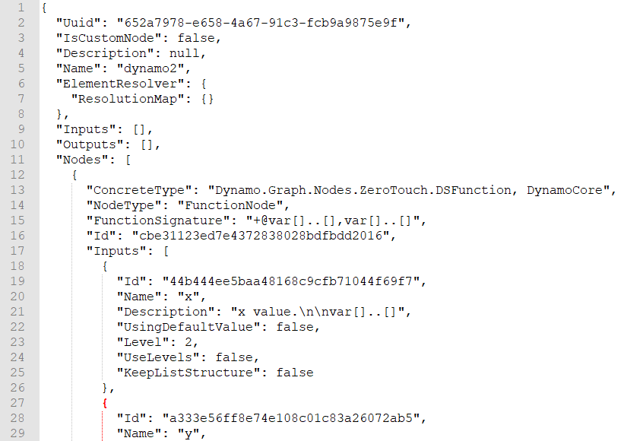
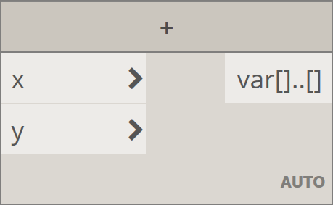
Version Differences – 2.0.x
New Appearance
Add-ons category for custom packages
Node in Dynamo 2.0.x
Auto-Lacing by default
JSON-Based file format
Note the “{}”

Slide 10
Dynamo 2.1.0
Released with Revit 2020 and only available on Revit 2020 as integrated product.
Remains compatible with other 2.0.x versions per semantic versioning. This means you have access to 2017-2020 compatibility.
Search improvements, overall more stable.

Slide 11
Future of Dynamo
Dynamo is open source, so staying up to date is relatively easy if you know where to look.
GitHub
Blog/Forum
Tweetz

Slide 12

Making Dynamo better with Packages

Slide 13














Install these (BOLD at a minimum or you are doing Dynamo wrong)
Revit Related
Lunchbox
Archi-lab.net
Clockwork
Spring nodes
Rhythm
Data-Shapes
Designtech
bimorph
Mandrill
Bumblebee
Bang!
More Awesomeness
Ladybug
Dynashape
Firefly
Mantis Shrimp
Rhynamo
*Is your favorite package missing from this list. Let me know! (I reuse this slide all the time and it may need updated)

Slide 14

Useful View Extensions
DynaMonito – Andreas Dieckman
https://github.com/andydandy74/Monito
Top Features :
Fixing Groups
Finding nodes
Templating
Managing Inputs

Slide 15


Useful View Extensions
DesignTech.io View Extension – Mark Thorley
https://github.com/MarkThorley/designtechViewExtension
Top Features:
Quick Access to Favorite Nodes
Quick Counts of Nodes/Wires

Slide 16

Useful View Extensions
Monocle – by some guy named john pierson
https://www.parallaxteam.com/monocle-for-dynamo-released/
Top Features :
Documenting nodes
Clean Dynamo Graphs
Being Memetastic

Slide 17

Useful View Extensions
IRIS for Dynamo - Eckart Schwerdtfeger
http://iris.parametrised.net/
Top Features :
Color coding beyond grouping
Serialization of data in file via node

Slide 18

Useful View Extensions
The-Saurus for Dynamo – Whole Team
https://github.com/mitevpi/thesaurus
Top Features :
Predictive Text for Nodes
Best Logo
Working towards #AutodeskBuyout

Slide 19
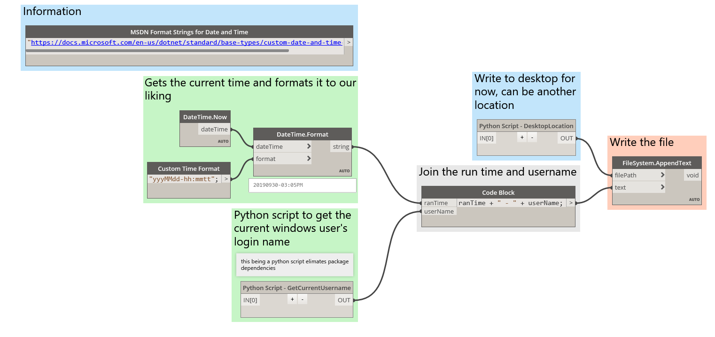
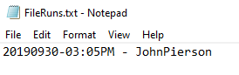
Strategy: Dynamo Graph Run Tracking with Nodes

Slide 20
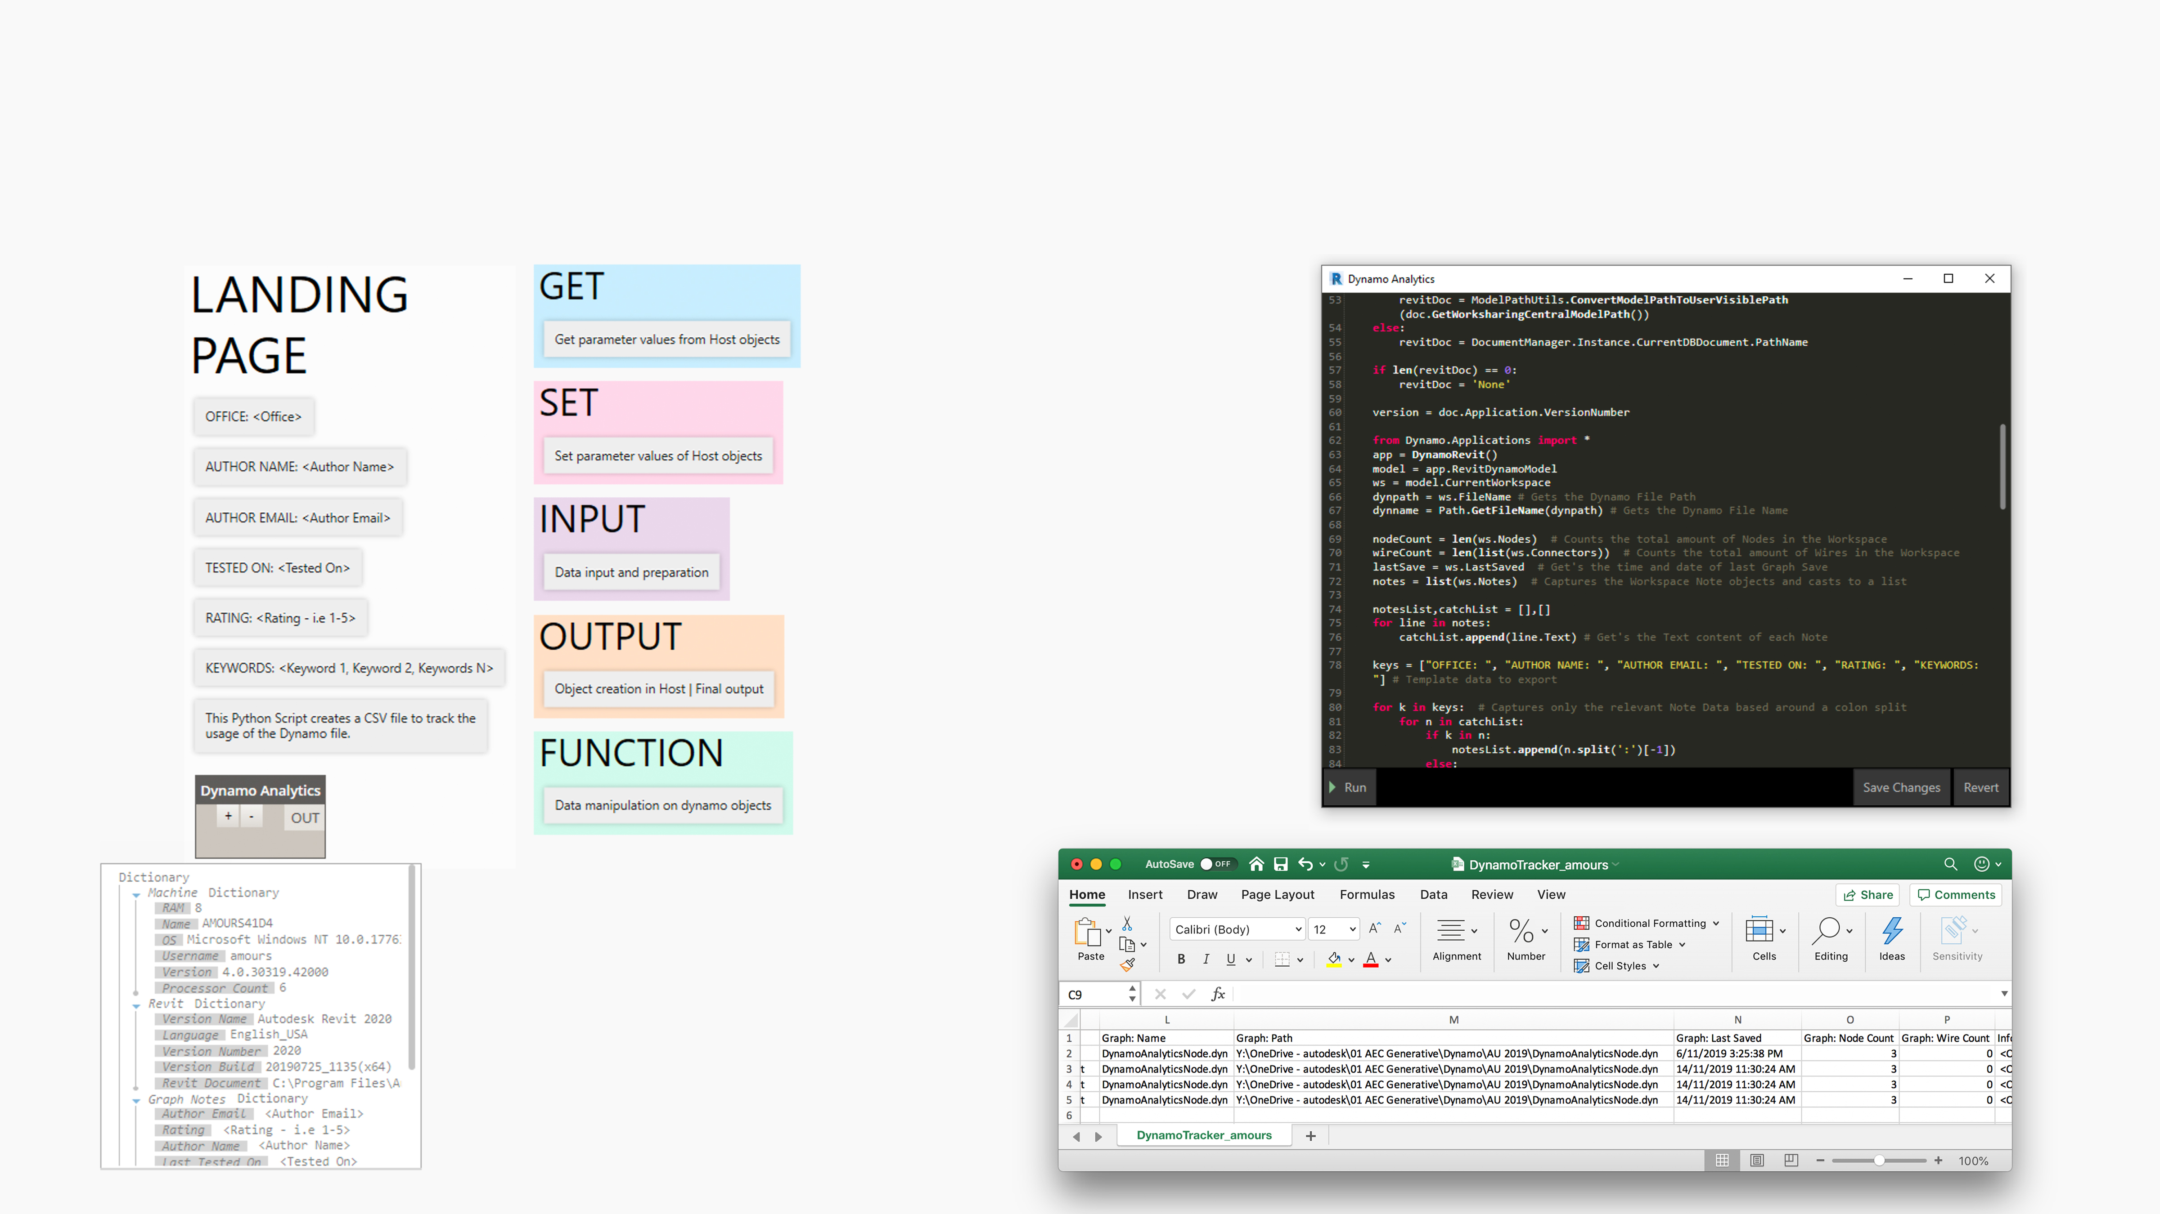
Strategy: Dynamo Graph Run Tracking with Python
Notes:
Users can play: Try changing text after the colon on 'Rating', 'Author Name' etc. Try renaming the graph. Try adding Nodes and Wires.

Slide 21
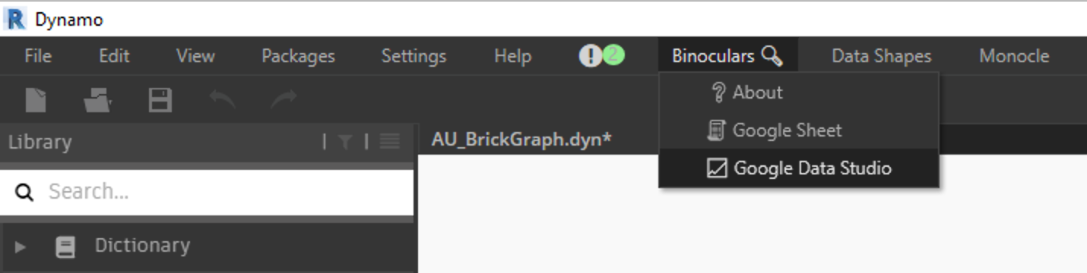
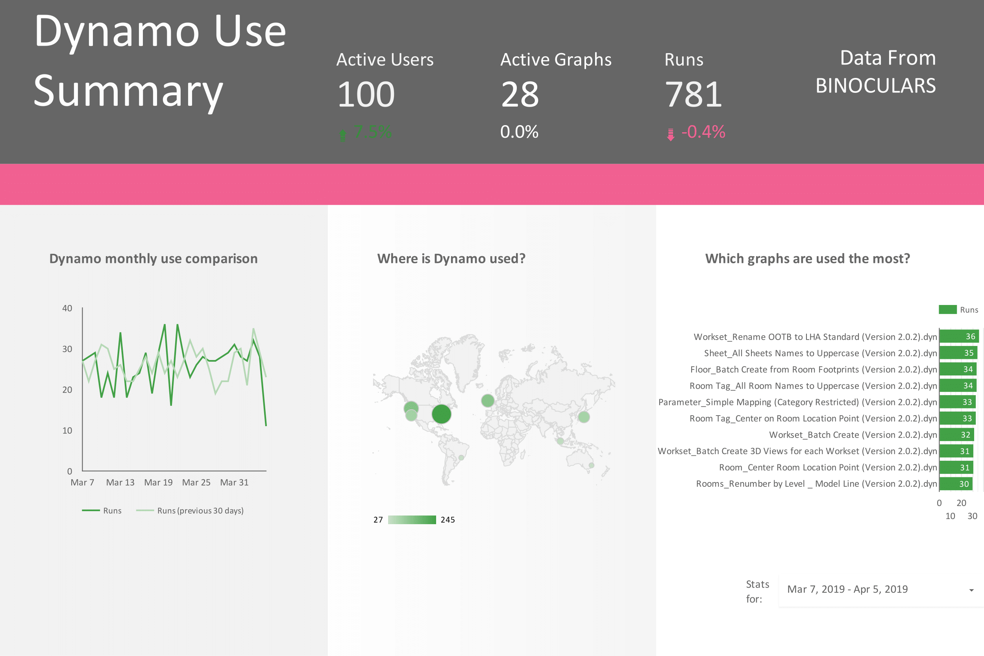
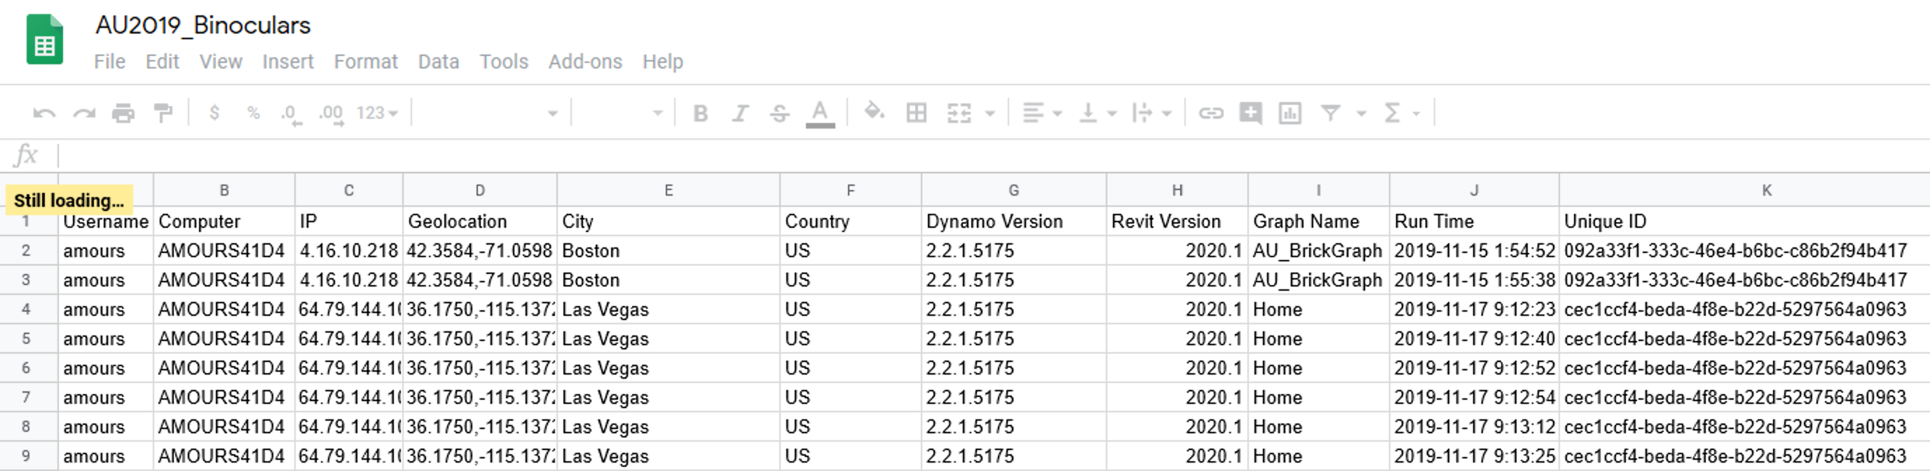
Strategy: Dynamo Graph Run Tracking with Binoculars
https://github.com/teamtreedyn/Binoculars

Slide 22

Dynamo Infrastructure

Slide 23
Element Binding?

Slide 24

teaching dynamo effectively

Slide 25

Teaching Others

Slide 26
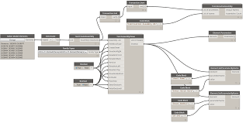
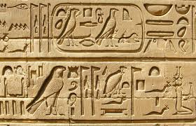
The Challenges
A very unusual way to interact with a design
Create a good athmosphere around it
Make a connection with real life use cases

Slide 27
Remember, we were all new Dynamo users once.

Slide 28
Lay the Foundations

Slide 29
Concept 1
Dynamo is a Visual Programming Environment

Slide 30
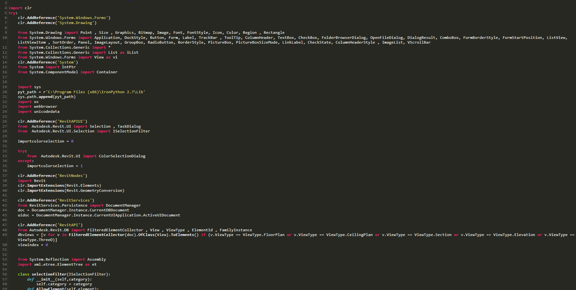
Programming
A set of instructions telling a computer how to perform a task or series of tasks using one of many coding languages

Slide 31
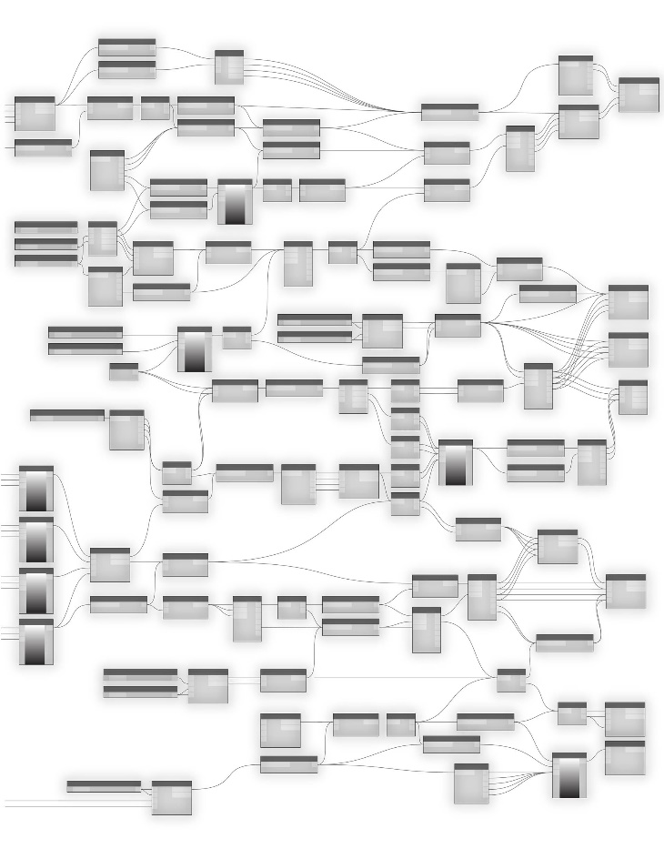
Visual Programming
A set of instructions telling a computer how to perform a task or series of tasks using a nodal interface

Slide 32
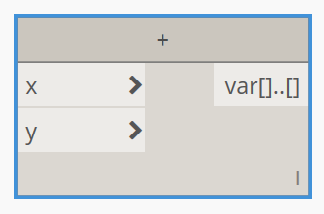
Code
Node
def addition(a,b):
sum = a + b
return sum
z = addition(x,y)
print(z)
Python
Dynamo

Slide 33
Concept 2
Understand the Data Flow

Slide 34
Anatomy of a Dynamo node
INPUT
OUTPUT

Slide 35
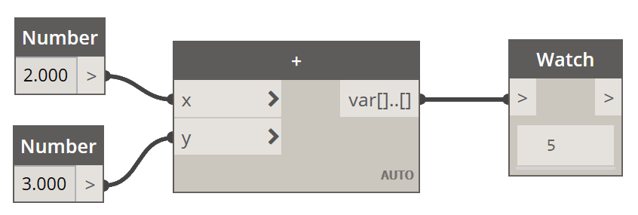
Anatomy of a Dynamo node

Slide 36
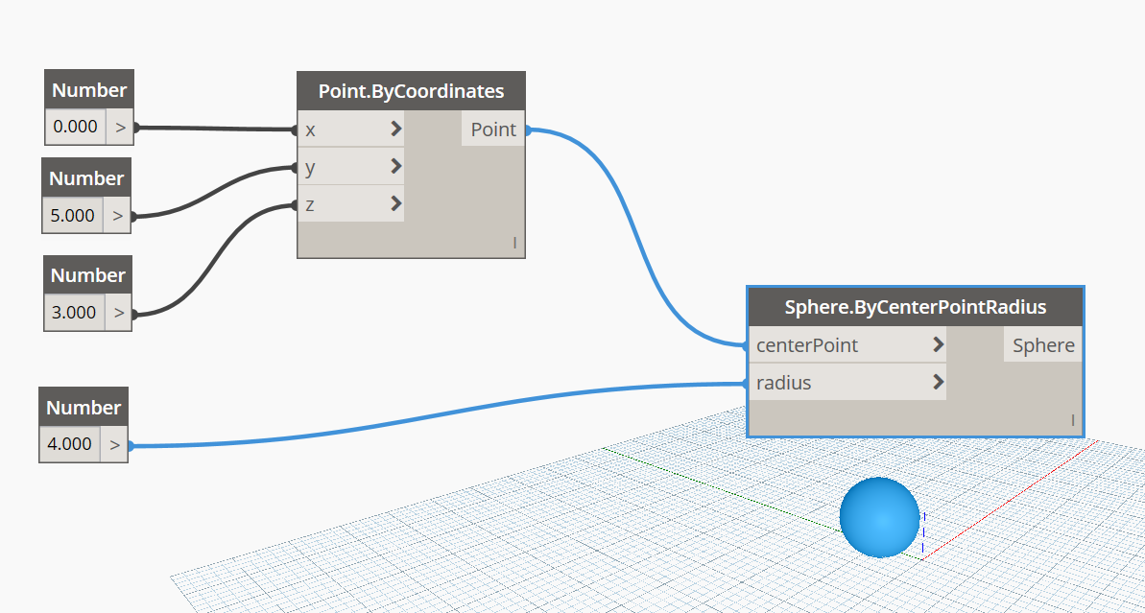
Anatomy of a Dynamo Script
Input
Task 1 : create a point
Task 2 : create a sphere using that point

Slide 37
Concept 3
Understand the Data Types

Slide 38
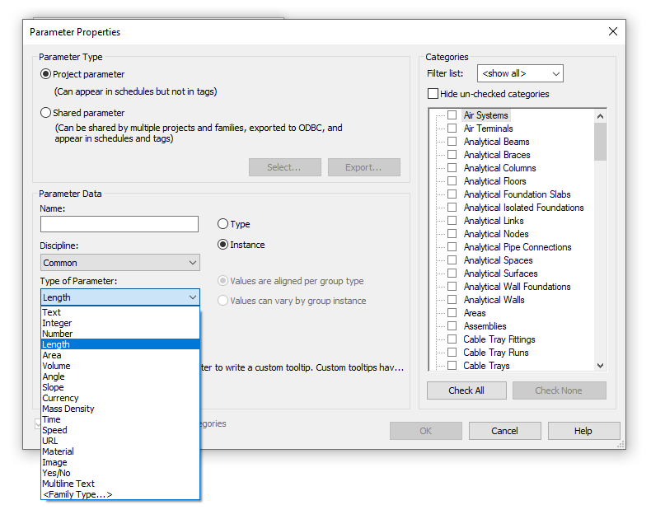
Data Types

Slide 39
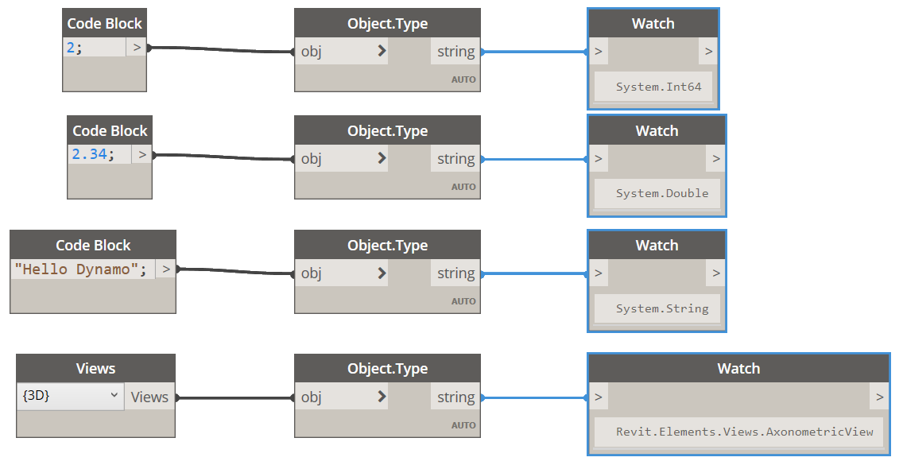
Data Types
If you want to figure the type of an element in Dynamo, there is a super useful node called “Object.Type”

Slide 40
Data Types
In general:
Integers: 1 , 2 , 2938
Float or Double: 2.367 , 653.87
String: Hello World
Boolean: True, False
Lists: [banana, apple, pineapple]
Geometry elements: lines, solids , meshes
Working With Dynamo for Revit:
Revit Elements: walls, floors, rooms etc.

Slide 41
Some More advanced Concepts

Slide 42
Lacing
Liste 1
A
B
Liste 2
1
2
3
4
5
6
Shortest
A
B
1
2
3
4
5
6
Longest
Lacing
A
B
1
2
3
4
5
6
Cross Product

Slide 43
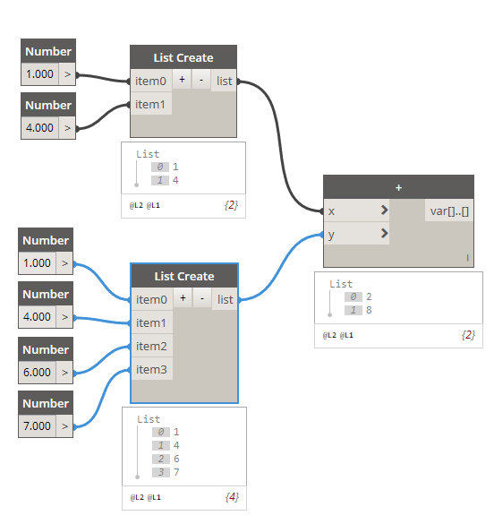
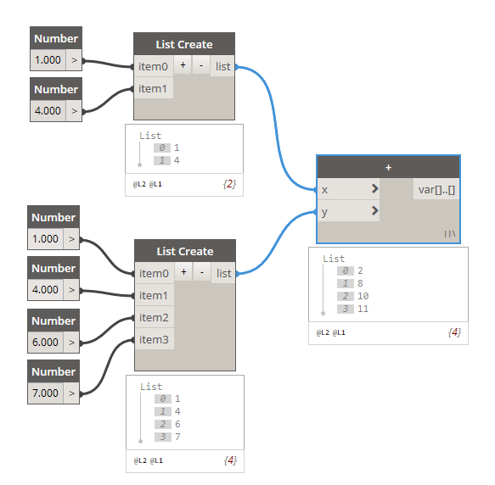
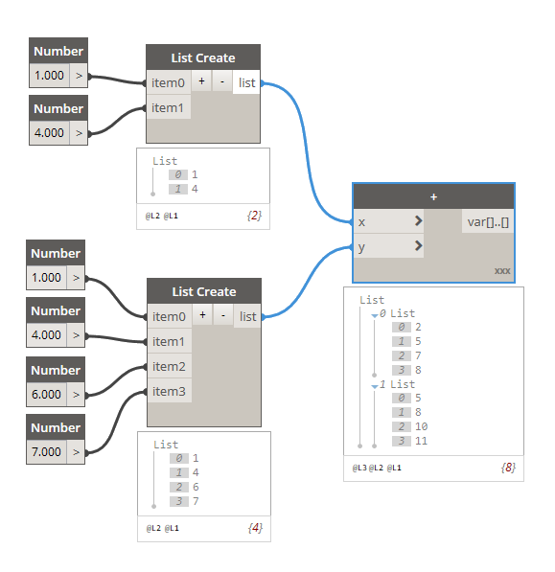
Lacing
Shortest
Longest
Cross Product

Slide 44
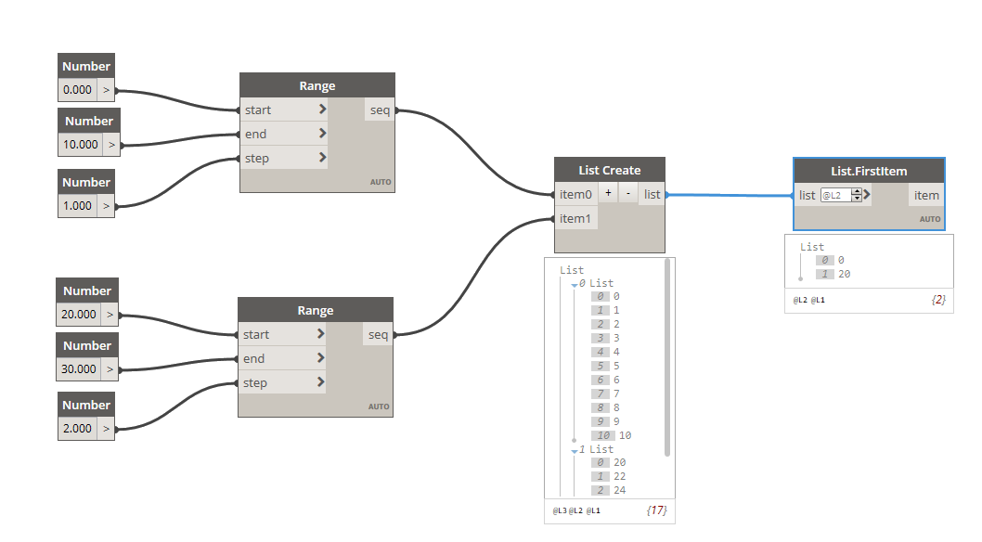
List@Level
First example

Slide 45
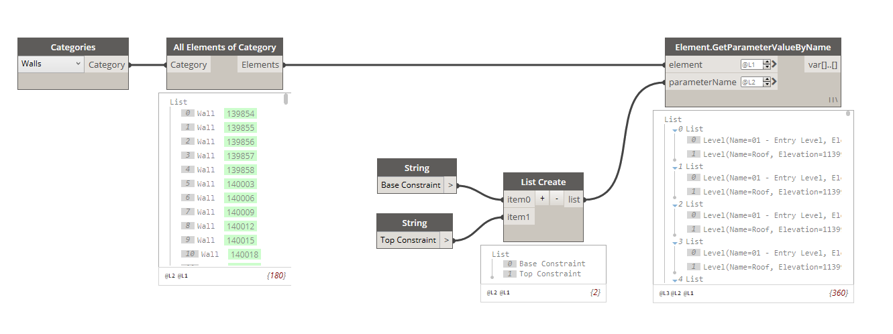
List@Level
Second example

Slide 46
Code Blocks
Dynamically links a visual programming environment with a text-based one.
The code-block has access to all the Dynamo nodes
Can define an entire graph or full parts of a graph in one node.
Lets you manage all sorts of data and even create dictionaries

Slide 47
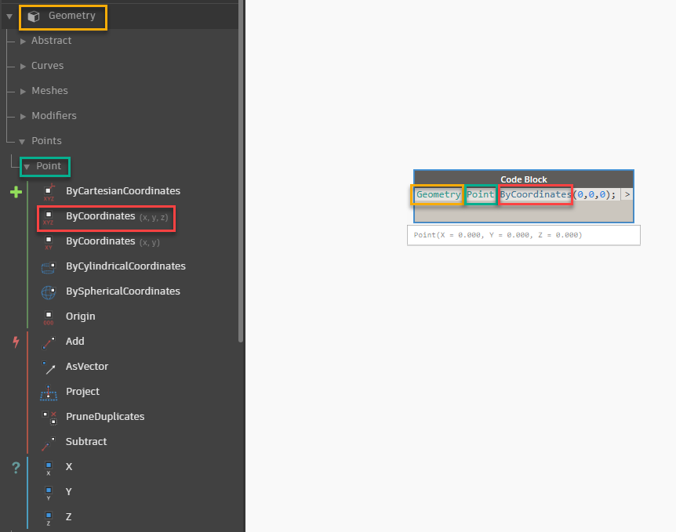
Code Blocks
Namespace : Geometry
Class : Point
Method/Property : ByCoordinates

Slide 48
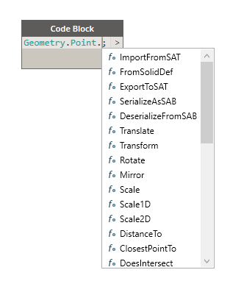
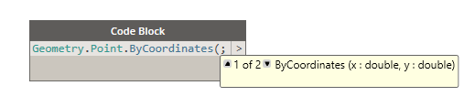
Code Blocks
Auto Completion

Slide 49
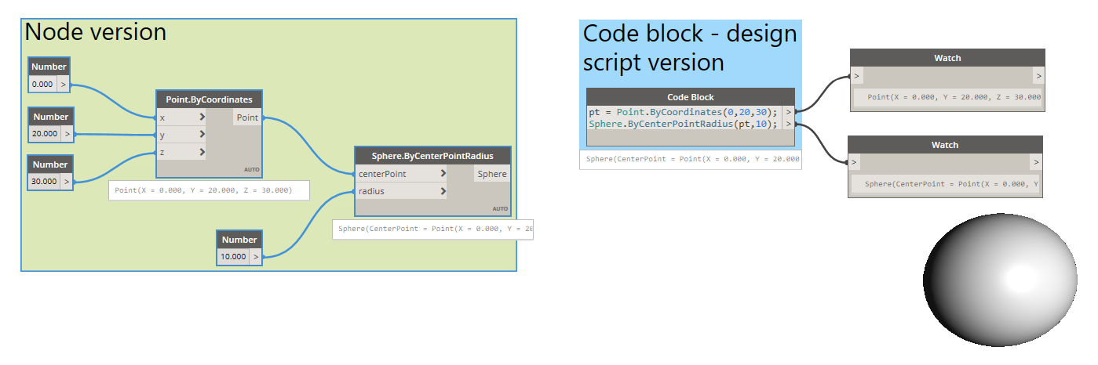
Code Blocks

Slide 50
Best Practices On Teaching

Slide 51

https://dynamobim.org/HowToTeachDynamo/

Slide 52
Some Advice

Slide 53
First solve the problem, then start scripting.

Slide 54
Draw a clear diagram of your strategy
Finding unused filters
Getting the list of all views
Getting the applied filters for each view
Check
Next step
List of filters to be tested

Slide 55
Encourage solution diversity

Slide 56

Let people know that there are often many solutions

Slide 57
Using real life analogies helps

Slide 58

Cooking analogy

Slide 59
Construction analogy

Slide 60
Don’t show people what YOU can do with Dynamo.

Slide 61
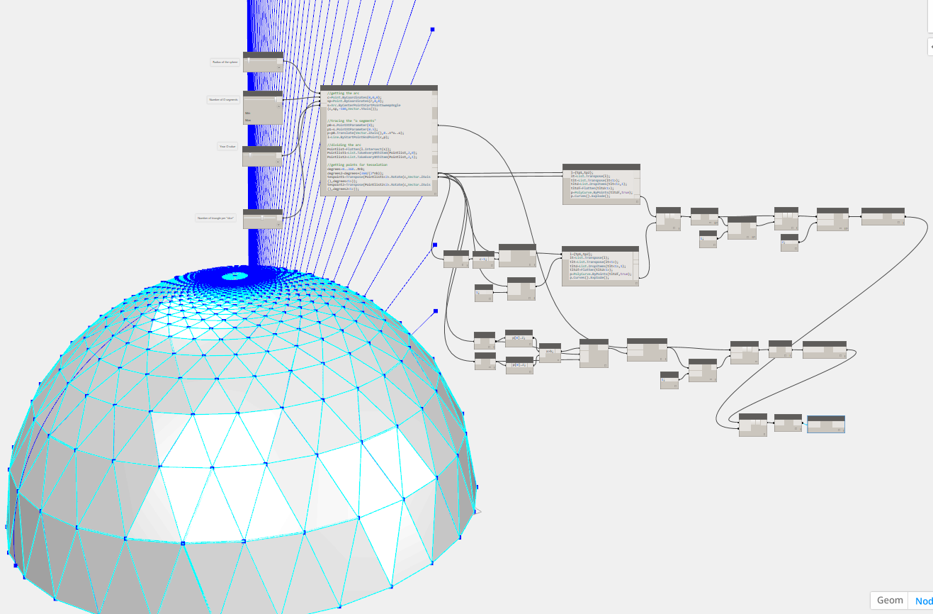
Too much at once can be intimidating

Slide 62
Show them what THEY can do with Dynamo.

Slide 63
Simple Real Life Use Cases

Slide 64
Use real life use cases that can help your peers understand and feel the power of Dynamo

Slide 65
For Architects
Renumbering Rooms

Slide 66
For Structural engineers
Placing piles on site topo

Slide 67
For MEP engineers
Generating Openings Automatically

Slide 68
For project managers
Getting Key Performance Indicators
File name
File size
Unplaced views
Warnings

Slide 69
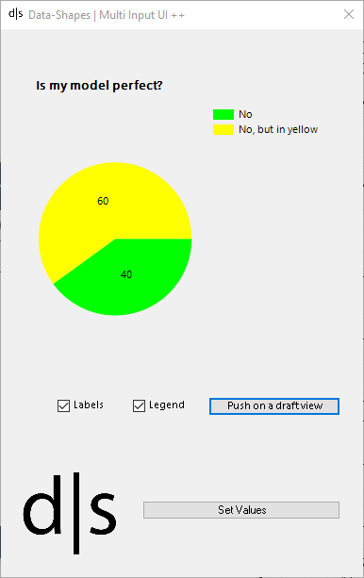
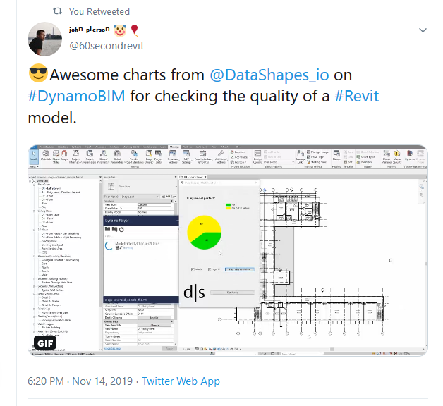
For project managers
Getting Key Performance Indicators

Slide 70
Nomenclature

Slide 71

shippable scripts

Slide 72
Graph Building Strategies

Slide 73
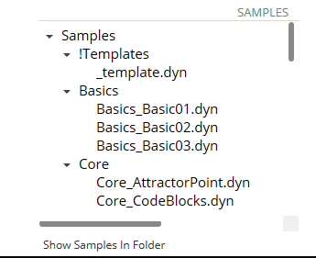
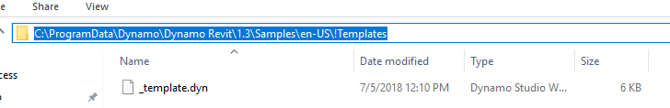
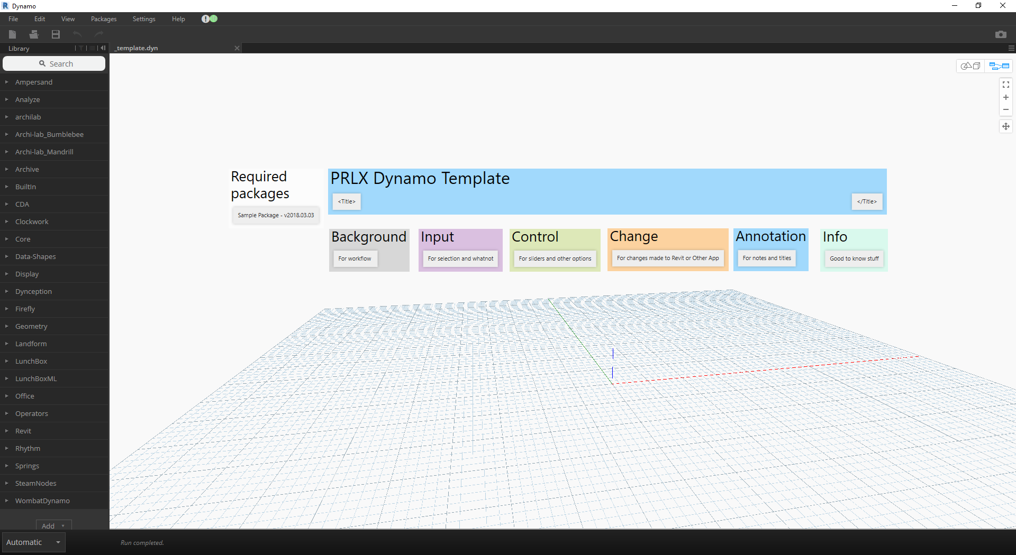
Strategy: Dynamo Template

Slide 74
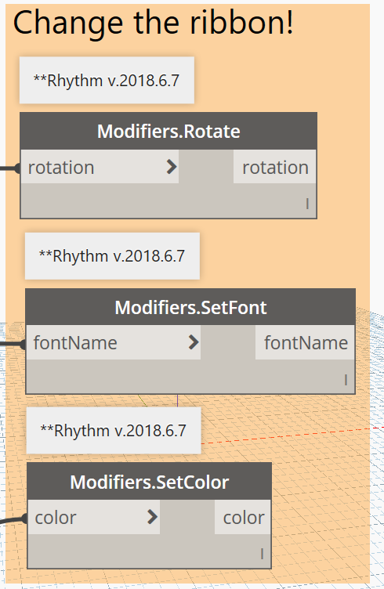
Strategy Annotating Nodes
Notes are added above each node (Ctrl+W on Keyboard or from View Tab).
Standard is to start with “**” to indicate that it is a custom package note, (more on this in a bit).
But, am I really expecting you to do this for EVERY node?

Slide 75
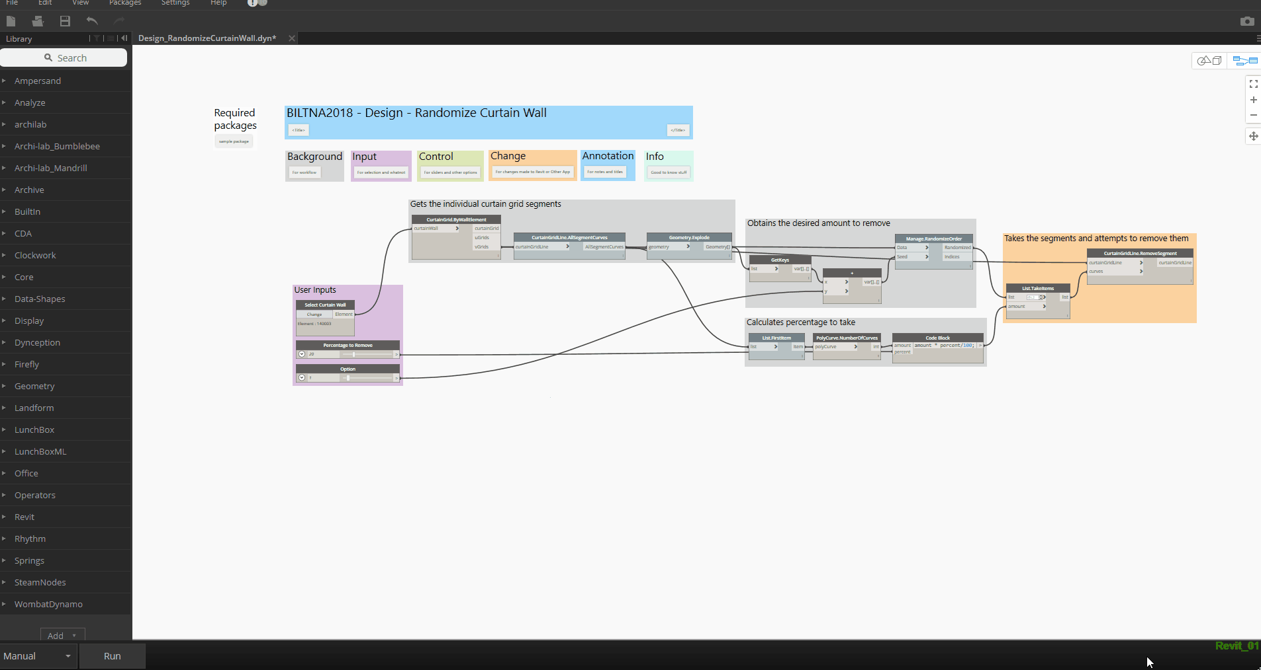
Yes I am. enter package usage doge

Slide 76

History of Dynamo Player

Slide 77
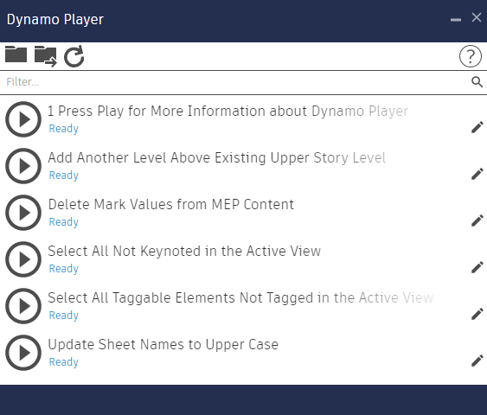
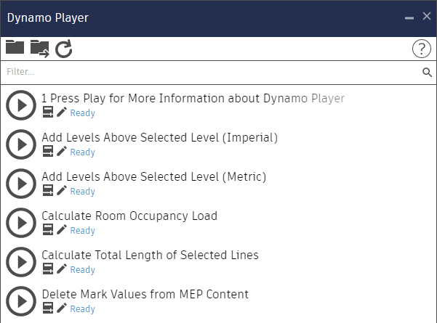
Revit 2017 Version
Revit 2018.1 Version
Revit 2017 introduced “Dynamo Player”, yay! Now we can push buttons to run our graphs! But without inputs..
Revit 2018.1 updated Dynamo Player to allow inputs. Ahhh, thank goodness.

Slide 78
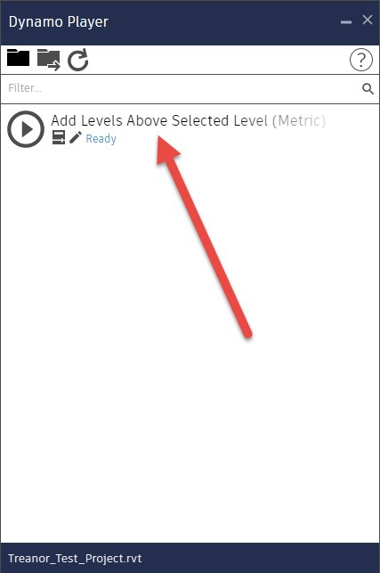
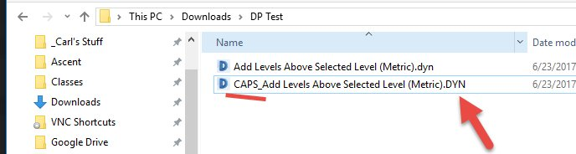

Considerations
File extensions with CAPITALS do not get recognized.
Credit: https://twitter.com/theBIMsider/status/1011777948481937409

Slide 79
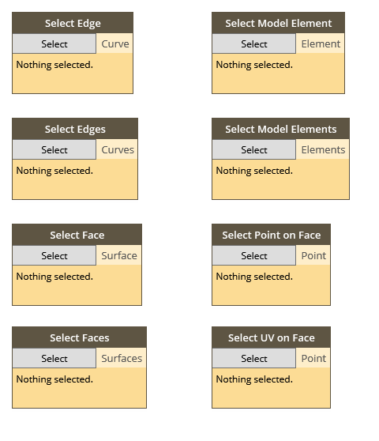
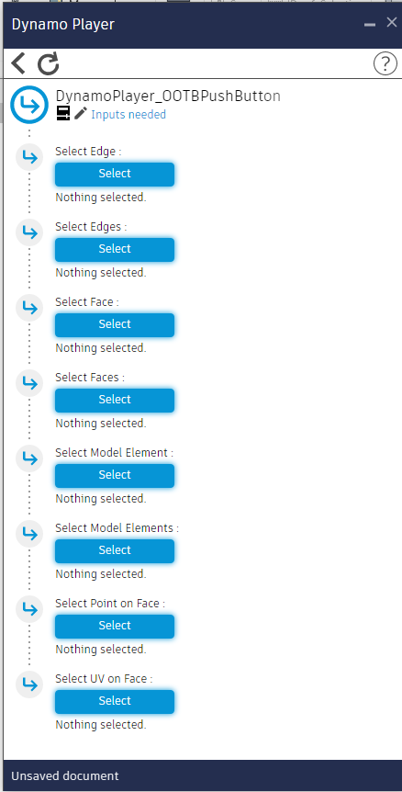
Support for OOTB Push Button Nodes

Slide 80
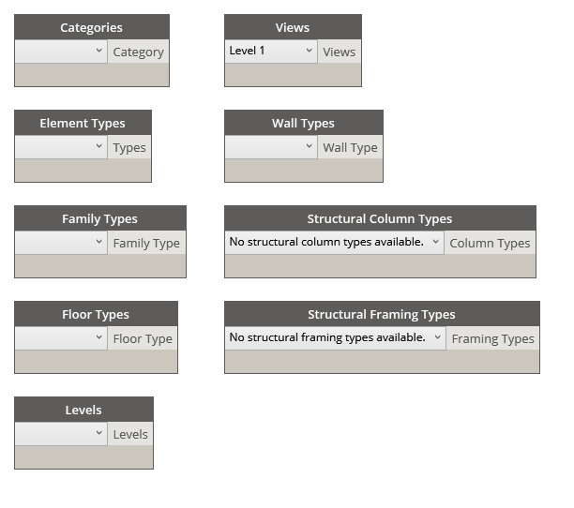
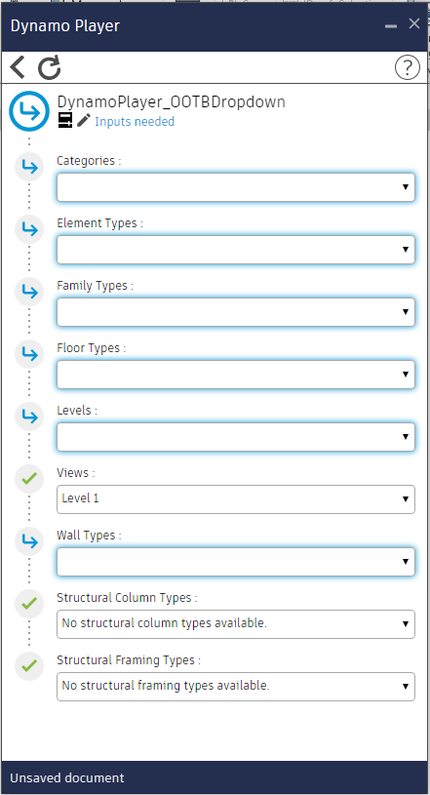
Support for OOTB Drop Downs

Slide 81
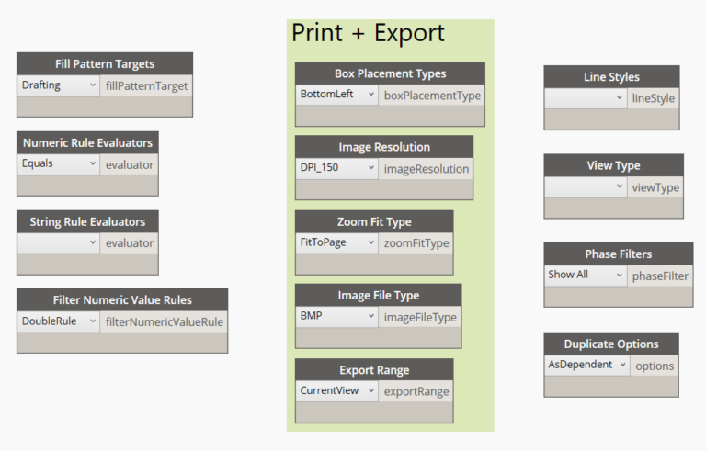

Bonus Dropdowns
archilab.net
rhythm

Slide 82


Custom Dynamo Popup UI

Slide 83

Custom UI allows us to….

Slide 84
Shippable Script 01 | 3D Room Tags
Good content = good workflow
Think it out
Fail-proofing your graph with Revit/Dynamo changes considered.

Slide 85
Shippable Script 02 | Remove Useless Room Separators
Think out the logic involved (how to do it manually)
Using a method of checking for difference between lists
Build with OOTB Dynamo Player Feedback

Slide 86
Shippable Script 03 | Load View Templates from Resource
Build out logic to work with background files
Make wicked UI for our users
Feedback via UI

Slide 87

a project’s journey

Slide 88
As a BIM Manager, it is important to know what can be done.

Slide 89
You don’t have to know how to do everything though…

Slide 90
Early / Conceptual
+ Awesomeness
+ Play with complexe geometries (tsplines)
+interop with rhino/grasshopper
+ physics (dynashape)
-messiness of that type of script
-hard to standardize / generalize
-takes a special set of skills

Slide 91

Early stage form finding / concept testing

Slide 92


Early stage form finding / concept testing

Slide 93

Early stage form finding / concept testing

Slide 94


Early stage form finding / concept testing

Slide 95


Early stage form finding / concept testing

Slide 96











Interoperability

Slide 97
Production / Documentation
Automation
Automate renumbering (rooms, doors, sheets, cats , dogs)
Automate sheet layouts
KPIs
Model health checking , warning management
Deal with complexity
Mastering complex geometry, deal with complex geometry for execution
Dynamo for advanced steel

Slide 98
QA / QC
Model health checking
Warning management
KPIs

Slide 99
Delivery

Slide 100
Autodesk and the Autodesk logo are registered trademarks or trademarks of Autodesk, Inc., and/or its subsidiaries and/or affiliates in the USA and/or other countries. All other brand names, product names, or trademarks belong to their respective holders. Autodesk reserves the right to alter product and services offerings, and specifications and pricing at any time without notice, and is not responsible for typographical or graphical errors that may appear in this document.
© 2019 Autodesk. All rights reserved.

